Slide 1

BOMBSHELL DIANA
ShobasakthI
Translator: Anushiya Ramaswamy

Slide 3
The Narrator?
The Setting?

Slide 4
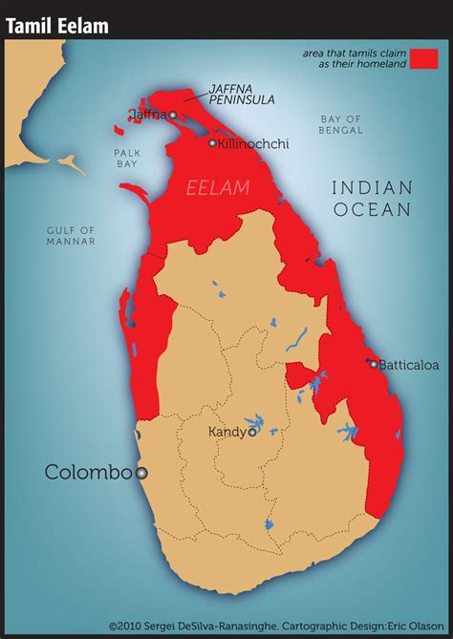
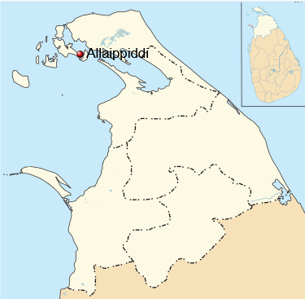
Sri Lanka/ Eelam

Slide 5
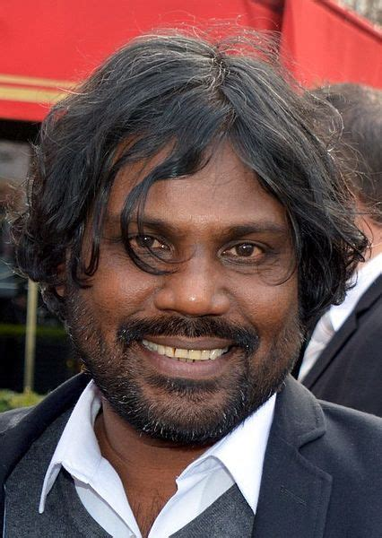



ShobasakthI
Pseudonym of Antonythasan Jesuthasan
Sri Lankan Tamil author and actor

Slide 6
Point of View
The angle of vision from which a story is told, The perspective/vantage point from which the reader comes to view reality, action, information.
The Author of the work is different from the Narrator of the story
First Person
the narrator is one of the characters who tells the story in the first person, in the "I" (the "I" must also exist outside of dialogue)
this character may be either a major or a minor character, protagonist or observer
Third Person
the narrator tells the story using the third person (he, she, they)

Slide 7
Types of Third Person PoV
Third Person Omniscient
s/he knows all and is free to tell us anything, including what the characters are thinking or feeling, and interpret their behavior (reveal why they do what they do)
Third Person Limited Omniscient
s/he limits herself to a complete knowledge of one character in the story and tells us only what that one character thinks, feels, sees, or hears
knows everything about the character—more, sometimes, than the character
Third Person Objective (or Dramatic)
s/he is a kind of roving sound camera that can go anywhere but can record only what is seen or heard; cannot comment, interpret, or enter a character's mind

Slide 8
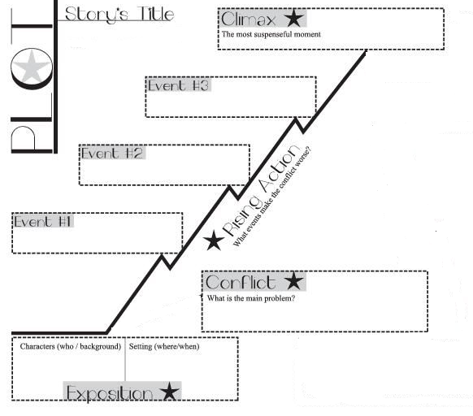
Fiction: Analytical TOOls

Slide 9
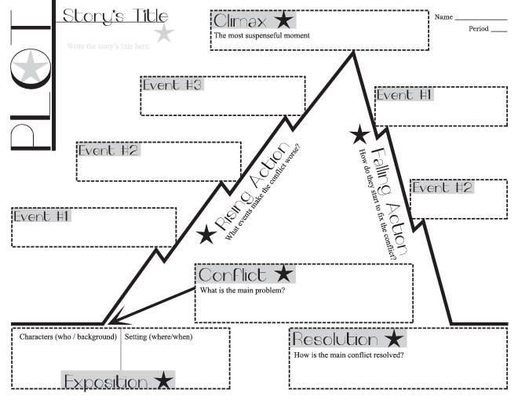
Narrator
Point of View
Characterization

Slide 10
To RECAP
2
1
The Author
The Context
Story Structure

Slide 11
Title
Exposition
Setting
Narrator-PoV
Characterization

Slide 12
Plot: Structure: Rising Action
EVENT 1
Tone?
Setting?
Narrator?

Slide 13
Event 1: The world into which diana is born
SETTING: A hospital—maternity ward
CHARCTERIZATION: women, children, nurses & their responses
CONFLICT: warplanes, bombs—stealth, threat, devastation
quick, deft details

Slide 14
Event 2: When diana was Three
SETTING: a night during the rainy season the walk through Kaithady bridge
CHARCTERIZATION: “the whole of Jaffna” Diana’s father “Mental Mahendram”, her mother
CONFLICT: searchlights of planes as pathfinder (irony) deliveries, deaths—as traffic blockages
quick, deft details

Slide 15
Event 2: When diana was Three
Diana’s peculiar condition

Slide 16
Events 3 & 4: Diana’s peculiar condition
EVENT 3
EVENT 4

Slide 17
Conflicts: changing shapes
State against its People
People against People
Self against itself
What it means to individualize struggles & conflicts

Slide 18
Events 5 & 6: The “Movement” & its Atrocities
The “Movement” [LTTE]
The cycle of Violence & Counterviolence
Representing People; Re-making the People
As a Quasi-state—laying out loyalties, punishments, duties
& Diana
EVENTS 5 & 6

Slide 19
Events 5 & 6: The “Movement” & its Atrocities
The “Movement” [LTTE]
The cycle of Violence & Counterviolence
Representing People; Re-making the People
As a Quasi-state—laying out loyalties, punishments, duties
& Diana
EVENTS 5 & 6

Slide 20
Events 5, 6, 7: The Cycle of Atrocities
The “Movement”
The State
Punishing the Spy, the Traitor
Conscription of child soldiers

Slide 21
Events 5, 6, 7: The Violence:
Redirected inwards (at the Self)

Slide 22
Events 5 & 6: The Violence:
Redirected outward (towards Others)
What it means to be de-humanized

Slide 23
Events 8…: counter/violence

Slide 24
The episode of the “dugout”
Fear of being bombed in the village/jungle

Slide 25
The episode of the “dugout”
The “minor” character/s
the cycle of counter/violence & beyond

Slide 26
The Domestic Drama
The swill of events
The domestic violence, broken marriage, anger, hurt
The “wooing”
The elopement
The angered “hysterical” wife & her “other”
The shocked, shamed parents
The threat of violence
The “consummation”/forced sex (?)
The Climax

Slide 27
Plot: Structure: Falling Action
Setting?
Narrator?

Slide 28
To return

Slide 29
The Questions raised by the Ending
The Narrator?
Third person Limited Omniscient, Third Person Objective?
Un/reliable?
Truth and Knowability?
Truth, Fact, Verifiability
The Human Condition?
Violence, Refugees, the scene of Law
The many deaths of Diana

